Slide 1

Overview of the purpose of the project
Caleb Edosomwan
ce155@student.le.ac.uk

Slide 2
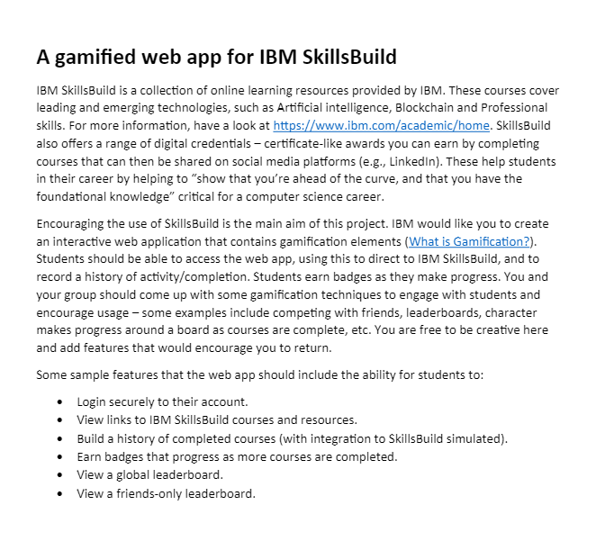
Project Brief
Notes:
So starting with the project brief, we were tasked by IBM to create an interactive web application. Students were supposed to be able to access the web app, and then be directed to the IBM SkillsBuild website, and record a history of their activity or completion. Students were then supposed to be able to earn badges as they made progress, and we as a group came up with some gamification techniques to engage with students and encourage further usage of the web application.

Slide 3
Project Aims
Notes:
So with this, our group had positive aims we intended to achieve through our project, as well as positive impacts we wanted the project to have, which served as the overall purpose of the project.

Slide 4
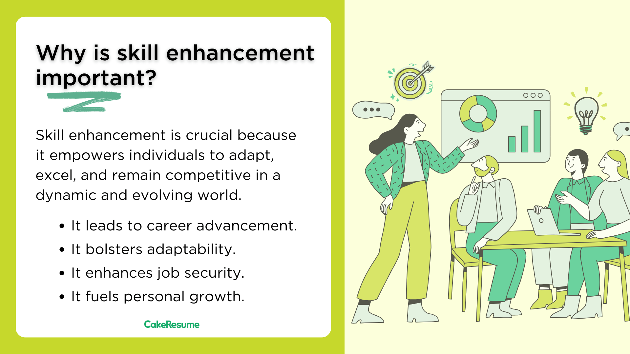
Skill Enhancement
Notes:
So one of our project aims was skill enhancement. Our platform aimed to empower aspiring students with the opportunity to enhance their skills and knowledge in various topics, including AI, Data Science, Cloud Computing and others.

Slide 5

Learning opportunities
Learn alongside regular school-work
More access to a vast range of high-quality modules
Notes:
Another one of our aims was creating more learning opportunities. Partnering with IBM SkillsBuild allowed us to provide access to a vast range of high-quality courses and modules for students to learn alongside their regular school work.

Slide 6

Career opportunities
Student empowerment
Pathway to their desired jobs or careers
Notes:
Another one of our aims was creating career opportunities. By creating more learning opportunities and making way for skill enhancement, we intended on empowering more aspiring students to have a solid gateway into their desired careers.

Slide 7
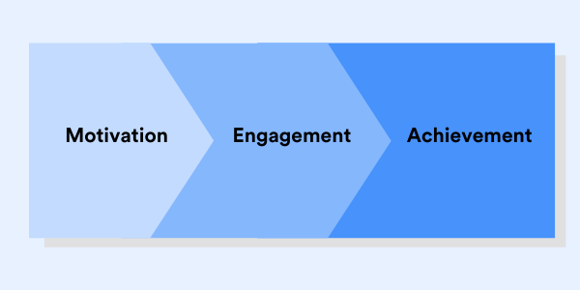
Engagement and motivation
Enhanced student motivation when doing work
Keeps them on track to achieve goals
Notes:
Another one of our aims was engagement and motivation. We wanted to create a platform that encouraged motivation and keep the students engaged throughout their learning journey. We intended on doing this by using gamification elements, that have a fun element in them, that keep students committed and on track with their learning goals.

Slide 8

Community building
Interactive with platform with other students
Students work and grow each other
Notes:
And lastly one of our aims was community building. We wanted our platform to be interactive with other users, so students can connect with others, share ideas, and support each other's growth.

Slide 9
Project Impacts
Notes:
With these aims, we wanted our platform to have positive impacts as our expected outcomes, and overall serve as the purpose of the project.

Slide 10
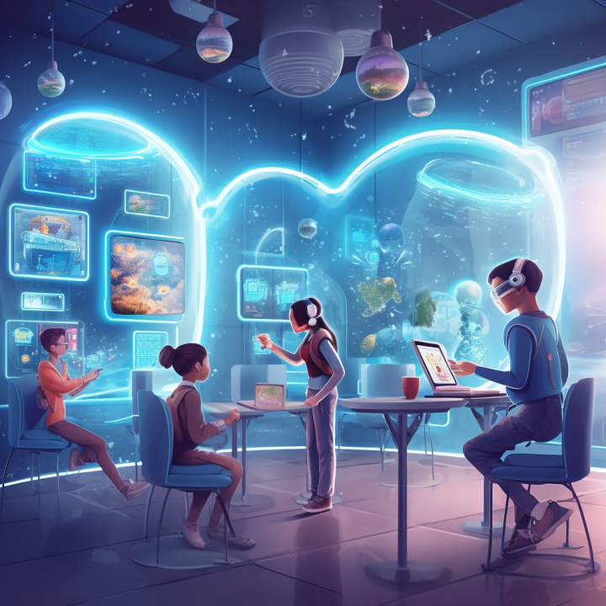
Innovation in education
Use of technology and gamification elements
More use of technology in education
Notes:
One of the first impacts we expected was innovation in education. By using the power of technology and gamification in our web application, we hoped that this project will provide and lead to a step forward in the use of technology in the world of education.

Slide 11

Smaller skills gap
Large skill gap between job seekers and employers
Promote learning the skills needed for high-end jobs
Notes:
Another one of the impacts we expected was a smaller skills gap. There is normally a large skills gap between the skills that job seekers and the skills that are required or wanted by employers. This web application promotes easier acquisition of skills needed for high-end jobs, and will hopefully pave the way for similar platforms that can help promote easier learning.

Slide 12

Easier access to education
Unattainable high quality educational resources
Promote easier access to learning resources
Notes:
And lastly one of the impacts we expected was general easier access to education. High quality educational resources are normally not easily attainable for the less privileged. Our web platform breaks a few barriers to education by providing accessible learning opportunities to users worldwide. We expect this to become a trend in the world of education and promote easier access to education.

Slide 13
Software design decision
Shogo Kojima
sk957student@le.ac.uk

Slide 14
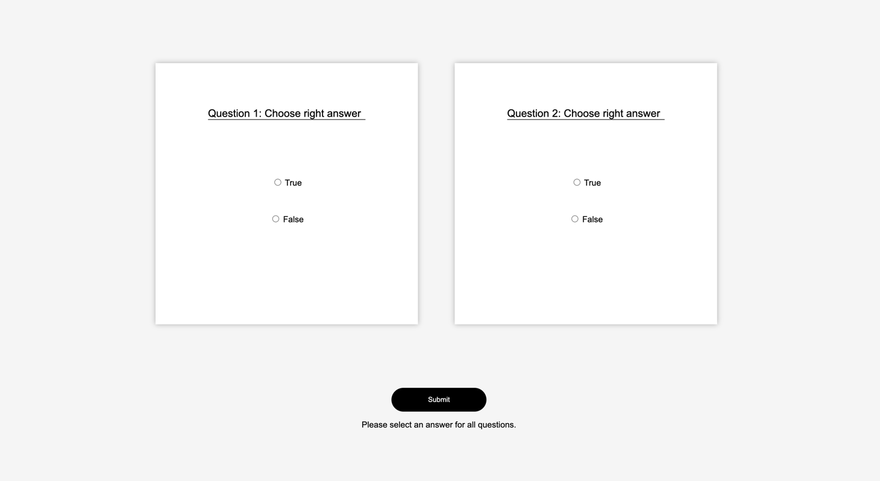
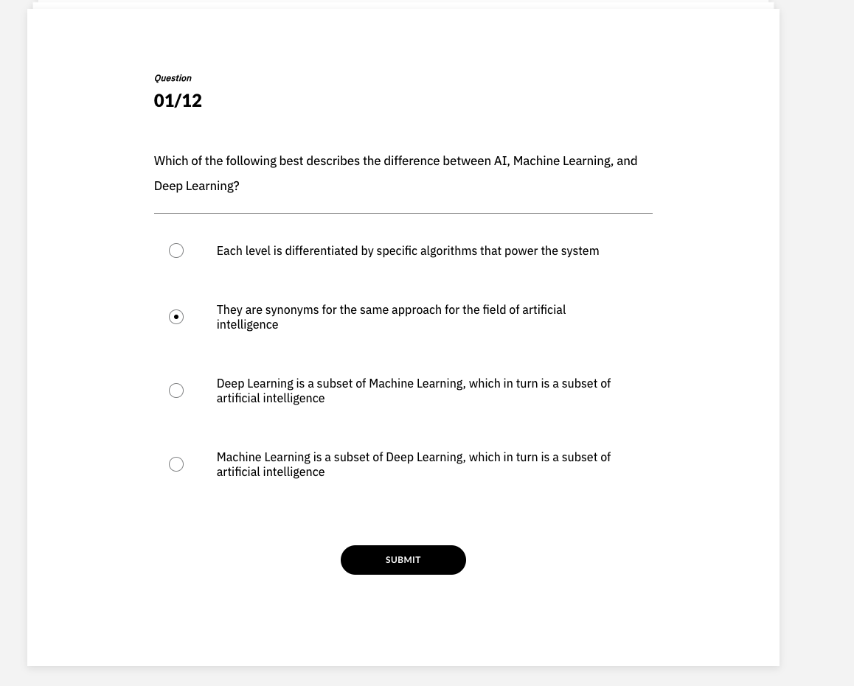
UI design
・Simplicity of Web Application
・Consistency of Design
Our website
IBM Skillsbuild

Slide 15
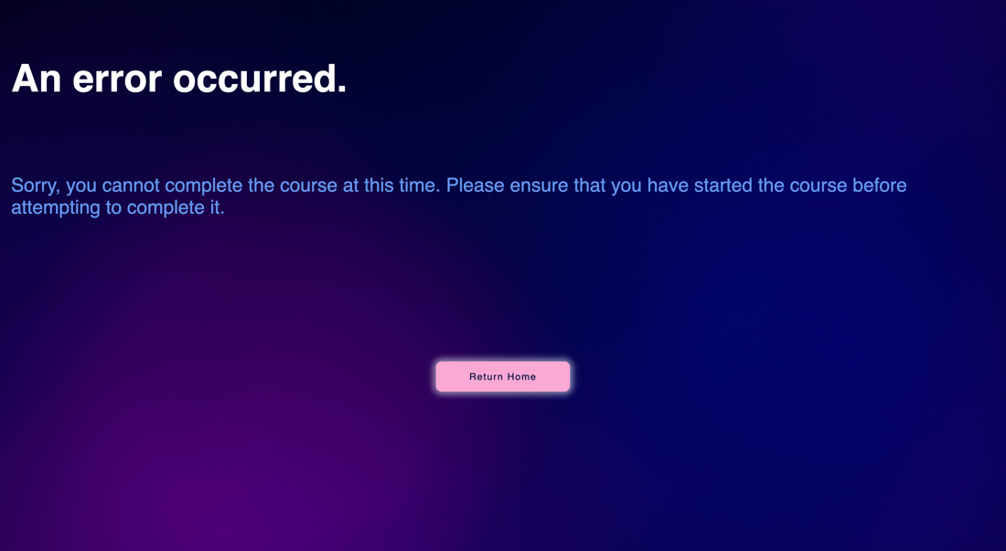
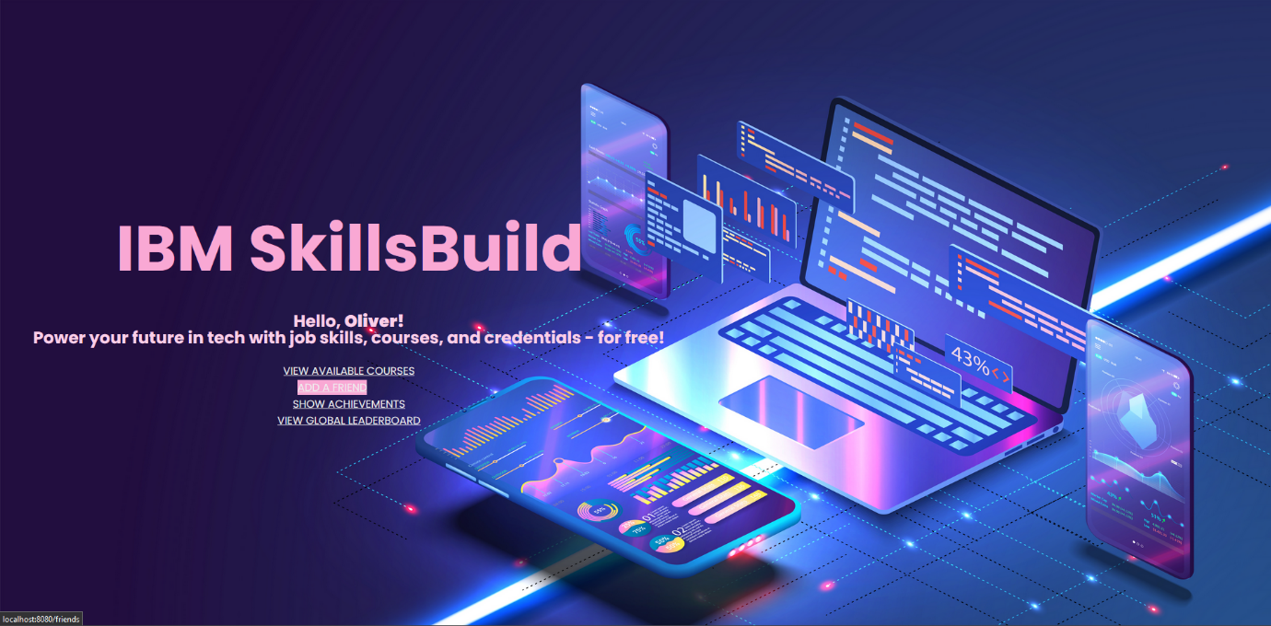
UI design
・Striking Design
・User-friendly Design
Error page
Home page

Slide 16




System Design
During the meeting, we discussed the tools to be used within the project, the rules within the group, and what additional functions would be needed for user stories other than the existing user stories.
Meeting
Rules
01
03
Tools
User Stories
02

Slide 17
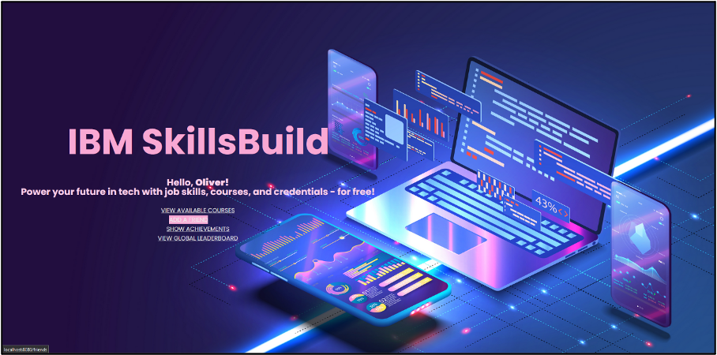
Realistic Plans For The Project
Oakker Myo
om105@student.le.ac.uk

Slide 18

Plans For Growth
Goal?
Improvements
Implementation

Slide 19
Improvements
Scaling - Content Expansion
Design - Principles
Gamification - Real-life Rewards

Slide 20
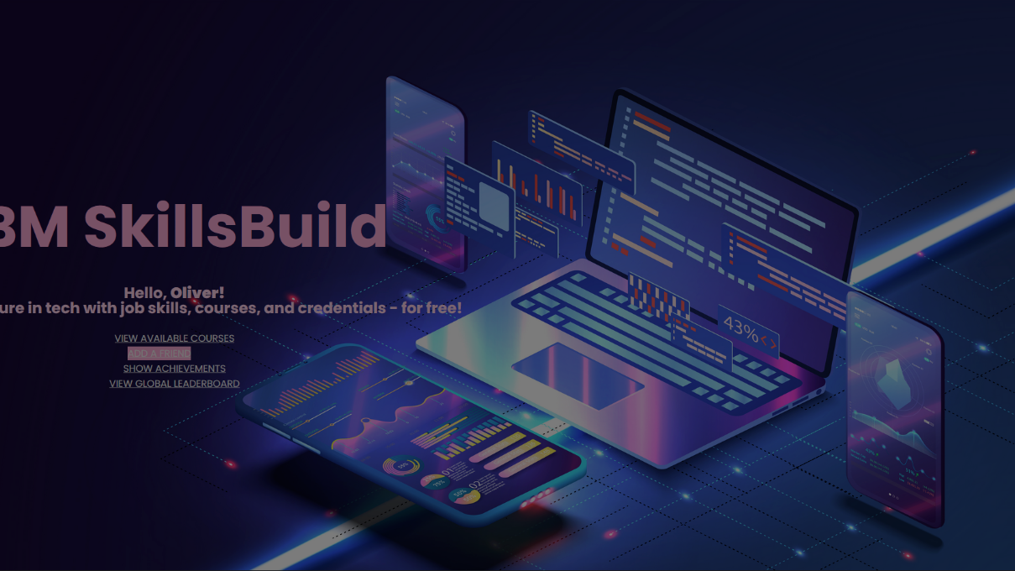



Implementation
Framework: Scrum
Time: 2 Sprints (2 months)
Resources: Partnership with University of Leicester

Slide 21
How We Calculated and Presented Course Time
Ciara McVeigh- cm831@student.le.ac.uk

Slide 22



Slide 23
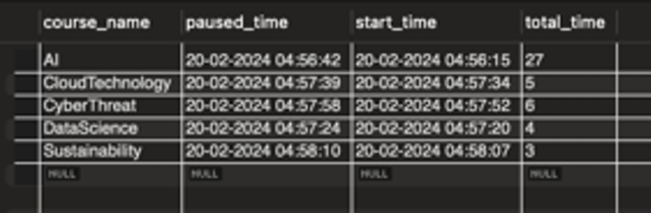
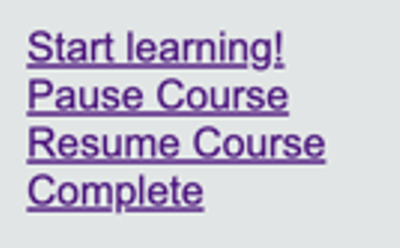
So, how does it work?

Slide 24
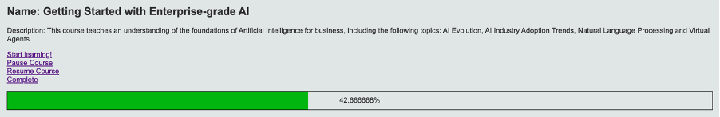

Slide 25
Security and login
Bhageerutty, Oliver G.

Slide 26

Notes:
We decided to use Okta to handle the login system

Slide 27
Benefits of okta
No local password storage
Tokens
Google login
Notes:
We used Oktas Oauth service. This is more secure than a local authentication system because:
The user doesn’t enter any sensitive info into our application as it is instead handled by an external provider, in this case Okta.
This means that we don’t have to keep password stored which is one less headache for developers.
An authentication token is sent to our program which expires after a certain amount of time meaning if a token is stolen by an attacker, then it will quickly become useless.
Its also very unlikely an attacker could intercept data as the Oauth 2 spec uses Transport Layer Security or TLS which is a modern security protocol that good encryption standards.
Okta supports logging in via google which is more convenient for the user as it is one less password to remember.
In the future, we could implement a different Oauth system that supports logging in via other big internet services.
Here are some examples of other companies that allow you to authenticate requests using their services. New slide with company logos

Slide 28






Notes:
Facebook, Google, GitHub, Twitter, LinkedIn, Microsoft, and Amazon

Slide 29
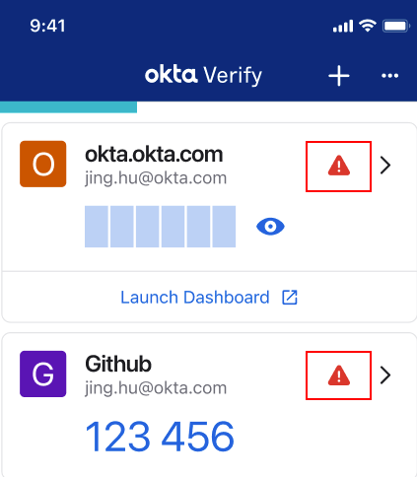
Future use of okta
2/Multi Factor Authentication
Notes:
Okta also supports 2 factor authentication which is something that we could implement in the future.
This involves using a trusted device to confirm any correct login attempts to ensure that the user is who they say they are.
It usually involves a phone receiving a temporary one time code or an app that uses algorithms to generate identical codes on both that device and the server, whichexpire every few seconds.
We could potentially implement this using the Okta’s 2 factor app called Verify.

Slide 30
Waqar Hassan
wah11@student.le.ac.uk

Slide 31
Group communication and planning
A vital part of the project
Allowed for planning to be done easily to fit the entire groups schedules
Enabled all of us to see how far along the entire project was
gave a good understanding of any areas that needed more attention

Slide 32
Methods of communication
Face to face: after lectures/labs
online calls: we had made a discord server and a WhatsApp group chat
Video calls: using Microsoft teams video calls were done to record the live demos for the project

Slide 33
How we communicated well during the project
Both the discord server and the whatsapp chat were used to discuss availability and any issues that had arisen with group members not being able to attend meetings or join calls
This allowed for the group to effectively have meetings with a target of at least 1 call a week
If any members did not come to the lab meetings or join the calls they could be informed on what was discussed on the whatsapp groupchat

Slide 34
How we could communicate better
Some weeks had very little contact which caused a lack of understanding on how far the project was getting along
Some meetings and calls were very short as there was either not much to update or no problems that needed addressing. This time could be used to plan slightly ahead for the coming tasks that may have needed doing.
We could better document and take note of what was being discussed in meetings

Slide 35
Ashish Furtado
af365@student.le.ac.uk

Slide 36

Social, Ethical and Legal Issues
Privacy Concerns:
We collect various types of user data to enable features such as friend requests and leaderboards. This data may include user profiles, activity logs, and interaction history within the application. It's crucial to be transparent about what data is collected and how it's used to ensure user trust and compliance with privacy regulations.

Slide 37

Social, Legal and Ethical Issues
Intellectual Property:
It is necessary to ensure that we clarify the intellectual property rights associated with our application, including trademarks and copyrighted content. This can be done by ensuring we obtain licenses for third-party assets used and following open-source licensing requirements.

Slide 38

Social, Legal and Ethical Issues
User Consent and Control:
It was vital that we obtained informed user consent for activities such as data collection and processing, including clear disclosure about the purposes and scope of data usage.

